Slide 1

Lecture 01-Introduction to Business Management
IT3090 -Business Management for IT-Lesson 01-Ms. Chalani Kuruppu

Slide 2
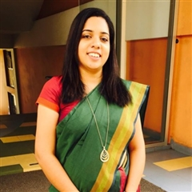
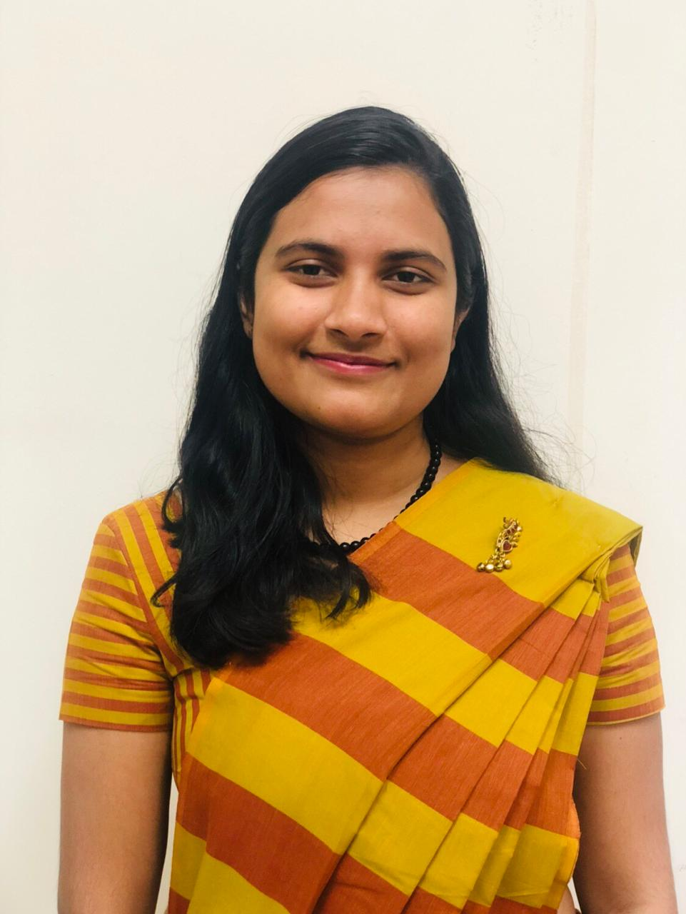
Module Leaders
Ms. Chalani Kuruppu
Senior Lecturer
SLIIT Business School
chalani.k@sliit.lk
Ms. Nilmini Rathnayake
Assistant Lecturer
SLIIT Business School
nilmini.r@sliit.lk

Slide 3
Introduction to the Module
Business Management for IT (IT3090)
Enrolment Key :IT3090
Maintenance of a subject files - PPT, Extra readings, newspaper/magazine articles, quizzes, pass papers, model answers
IT3090 -Business Management for IT-Lesson 01-Ms. Chalani Kuruppu

Slide 4
Content
Introduction to Business Management
The Basics of Management
Managing People
Accounting for Business
Managing the Cost and Financing
Analysis of Financial Statements
Introduction to Economics
Marketing Concepts and Poster's Value Chain
IT3090 -Business Management for IT-Lesson 01-Ms. Chalani Kuruppu

Slide 5

Assessment
Continuous Assessments
- Online Quiz(Week 8) 20%
End Semester Assessment
- Final Examination 80%
IT3090 -Business Management for IT-Lesson 01-Ms. Chalani Kuruppu

Slide 6
Learning Outcomes
At the end of the session students will be able to;
Explain nature of a business organization
Explain key problem associated with any business organization
Describe the need for management
Explain the types and forms of business
IT3090 -Business Management for IT-Lesson 01-Ms. Chalani Kuruppu

Slide 7



Business Organization
A business organization is a, group of people working together to satisfy human needs and wants by producing goods and services with a common objective of profit maximization.
IT3090 -Business Management for IT-Lesson 01-Ms. Chalani Kuruppu

Slide 8



Productive Resources
Operating cost
Land
Entrepreneurship
Labor
Capital
IT3090 -Business Management for IT-Lesson 01-Ms. Chalani Kuruppu

Slide 9
Business Functions; buy, make, sell, trade
Buy/acquire
Make/Process
Sell or Trade
Labor
Material
Capital
Technology
Equipment and machineries
Knowledge and information etc
Warehouse
Production and operations
Marketing
Financing and accounting
Human resource management etc
Research and development (R&D)
Selling and distribution
Exchange, trade of goods and services
IT3090 -Business Management for IT-Lesson 01-Ms. Chalani Kuruppu

Slide 10
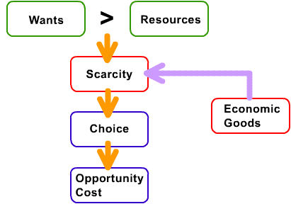
What is the basic economic problem?
What is the basic economic problem ?
IT3090 -Business Management for IT-Lesson 01-Ms. Chalani Kuruppu

Slide 11
Why do we study management?
Universality of management
The reality of work
The rewards and challenges of being a manager.
IT3090 -Business Management for IT-Lesson 01-Ms. Chalani Kuruppu

Slide 12
What Is Management?
The art of getting things done through people.
The process of,
Planning, Organizing, Leading and Controlling the work of the organization members and using all available organizational resources to reach stated organizational goals, efficiently and effectively in an ever changing business environment.
IT3090 -Business Management for IT-Lesson 01-Ms. Chalani Kuruppu

Slide 13
The Process of Management
0
Planning
Select goals and ways to attain them
Resources
Performance
Human
Financial
Raw Materials
Technological
Information
Attain goals
Products
Services
Efficiency
Effectiveness
Controlling
Organizing
Monitor activities and make corrections
Assign responsibility for task accomplishment
Leading
Use influence to motivate employees
IT3090 -Business Management for IT-Lesson 01-Ms. Chalani Kuruppu

Slide 14

Who Are Managers?
Someone who coordinates and oversees the work of other people so
that organizational goals can be accomplished.
IT3090 -Business Management for IT-Lesson 01-Ms. Chalani Kuruppu

Slide 15
Types of Managers/ Levels of Management
First-line managers
Middle managers
Top managers
IT3090 -Business Management for IT-Lesson 01-Ms. Chalani Kuruppu

Slide 16
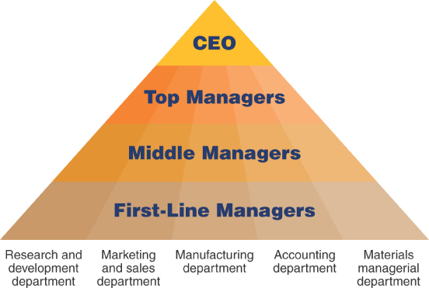
Types of Managers/ Levels of Management
IT3090 -Business Management for IT-Lesson 01-Ms. Chalani Kuruppu

Slide 17

Types Business Organizations
Service providing business organizations
Manufacturing organizations
Trading organizations
IT3090 -Business Management for IT-Lesson 01-Ms. Chalani Kuruppu

Slide 18
Principal forms of business organizations
Sole proprietorship
Partnerships
Companies
Non-profit making organizations
IT3090 -Business Management for IT-Lesson 01-Ms. Chalani Kuruppu

Slide 19

Sole Proprietorships
The most simple and common form of business.
Owned and control by an individual.
The law basically treats the business and the owner as one and the same ( no legal personality).
Personally liable for all debts or losses (unlimited liability).
The business carried on its’ own name.
IT3090 -Business Management for IT-Lesson 01-Ms. Chalani Kuruppu

Slide 20

Partnerships
A partnership is an agreement between two or more persons to operate a business(2-20)
Partners should formulate an agreement to make decisions on:
- How profits and losses are to be shared among the partners.
- How much money they should invest to the business
- Their responsibilities in the management
No legal personality
IT3090 -Business Management for IT-Lesson 01-Ms. Chalani Kuruppu

Slide 21
Partners are personally liable for business debts (unlimited liability)
Partnership dissolves when a partner dies or the expiration of the specified time period.
Widely used for small businesses and professional practices
Advantages???
Disadvantages???

Slide 22

Companies
Companies limited by shares
Companies limited by guarantee
Companies with unlimited liability
IT3090 -Business Management for IT-Lesson 01-Ms. Chalani Kuruppu

Slide 23
Limited Companies
These organizations should incorporate under the ‘Companies Act no 07 of 2007’.
The liability of the shareholders of a corporation is limited to the amount of their capital contribution
The Company has a separate legal personality
The Companies can raise more funds
Separation of ownership and management
Perpetual life
IT3090 -Business Management for IT-Lesson 01-Ms. Chalani Kuruppu

Slide 24
Types of Limited Companies
Limited Companies
Private Limited Companies
Public Limited Companies

Slide 25
Private Limited Companies
Maximum 50 shareholders and should consist at least one director
No shares can be offered for sale to the general public
Consent of all shareholders is required to transfer shares to a new shareholder
Not allowed to raise funds by issuing debentures
The last two words of the name should be read as either “(Private) Limited” or “(Pvt) Ltd”
IT3090 -Business Management for IT-Lesson 01-Ms. Chalani Kuruppu

Slide 26
Public Limited Companies
No limit to the maximum number of shareholders and should consist at least two directors.
Can offer shares for sale to the general public
No restriction on the transferability of shares, if listed in the CSE.
Allowed to raise funds by issuing debentures
The last word of the name should be read as either as “Public Limited Company” or “PLC” if the company is a listed company. If not the name should be as “Limited” or (‘LTD’)
IT3090 -Business Management for IT-Lesson 01-Ms. Chalani Kuruppu

Slide 27
Thank you!
IT3090 -Business Management for IT-Lesson 01-Ms. Chalani Kuruppu

